Slide 1


Slide 2



Next Generation Project Management
- An NGSIS Story
Vikram Chadalawada MBA, PMP, Cert.APM
Project Manager (NGSIS Program)

Slide 3
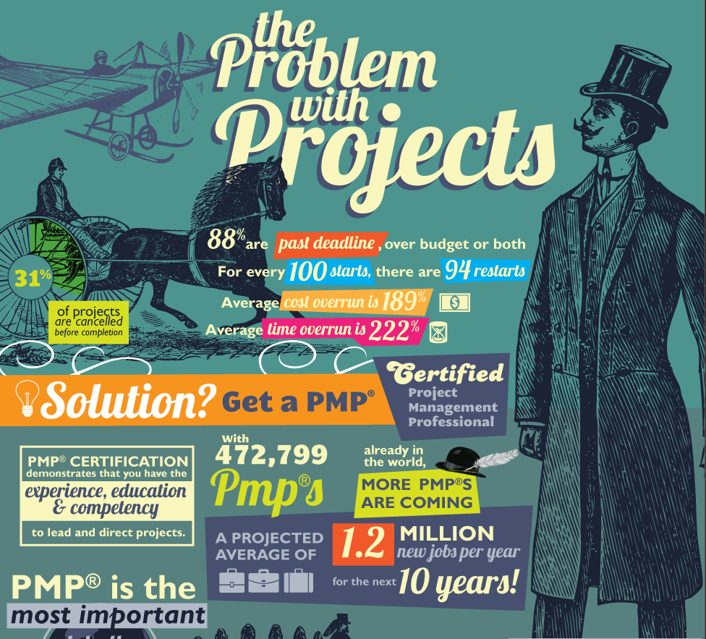
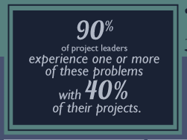

Slide 4
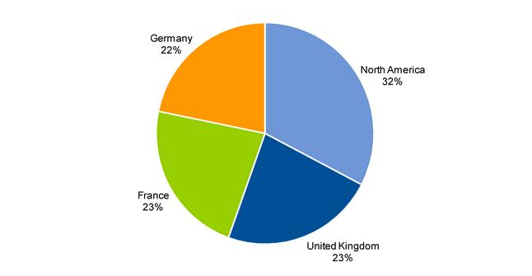

Survey on IT Project Management
Geographic Distribution of Respondents
Survey Details:
154 organizations across the globe
All respondents were required to manage or work within their organization’s project management function.
Source: Gartner (June 2012)

Slide 5
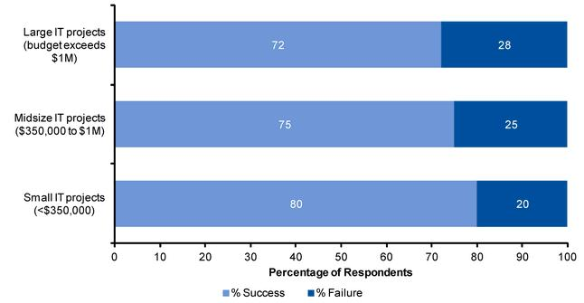
Current State of Project Management
Distribution of Success and Failure Across Project Sizes
Survey Details:
154 organizations across the globe
All respondents were required to manage or work within their organization’s project management function.
Source: Gartner (June 2012)

Slide 6
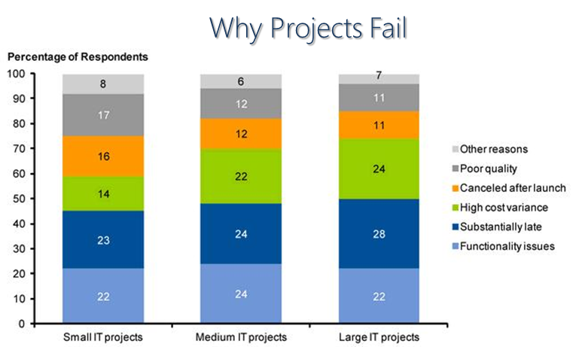
Survey Details:
154 organizations across the globe
All respondents were required to manage or work within their organization’s project management function.
Source: Gartner (June 2012)

Slide 7


Slide 8

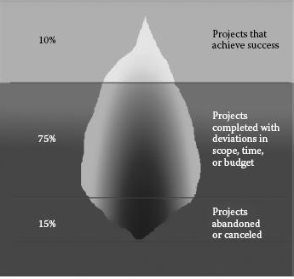
The Project Iceberg

Slide 9
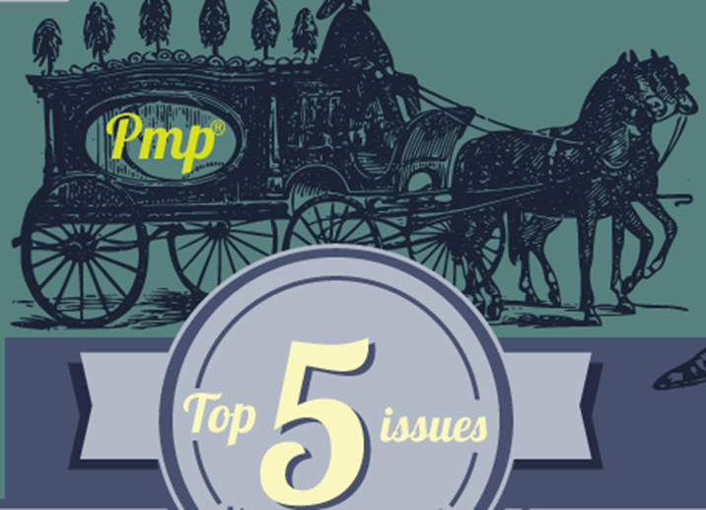
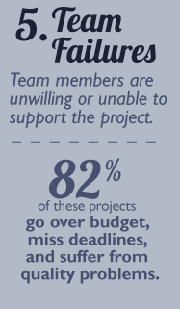
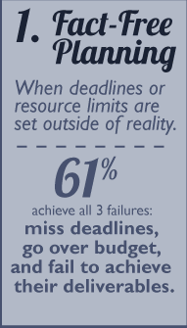
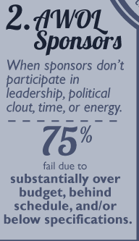
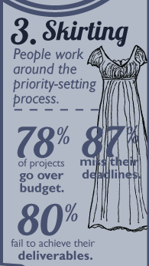
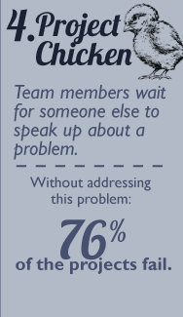
Qualitative Reasons for Project Failures

Slide 10
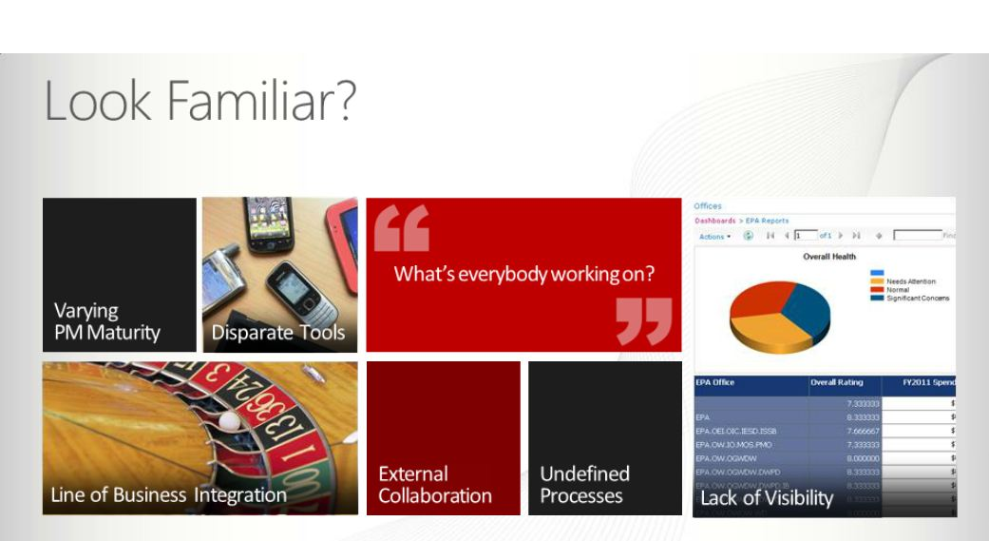
The need for collaboration

Slide 11

The Project Central story
- As real as it gets

Slide 12
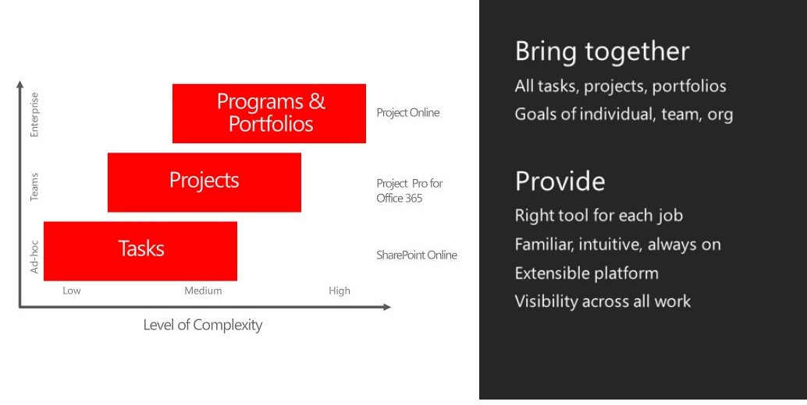
The NGSIS Vision…

Slide 13
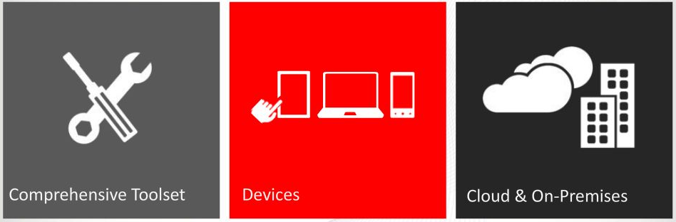
The NGSIS Goal
A comprehensive set of tools delivered to almost any device through the cloud or on-premise

Slide 14
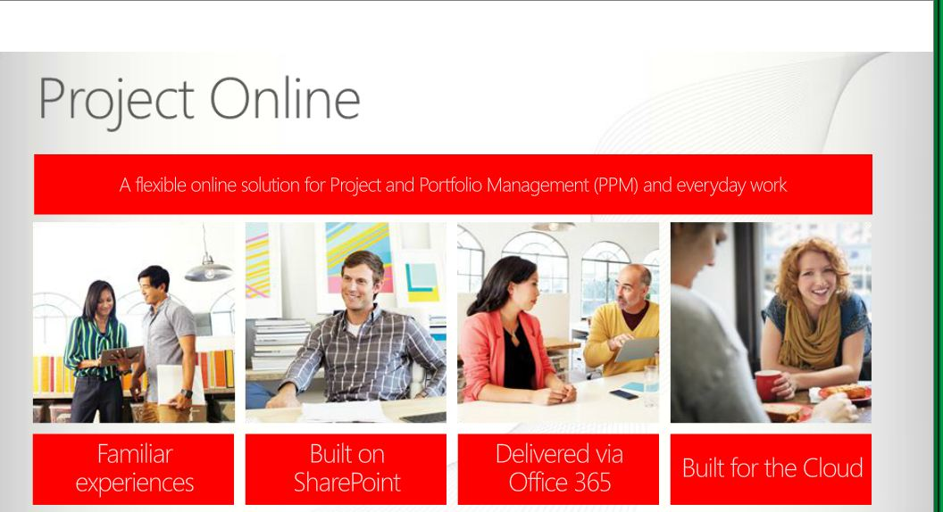
The Unified Framework

Slide 15
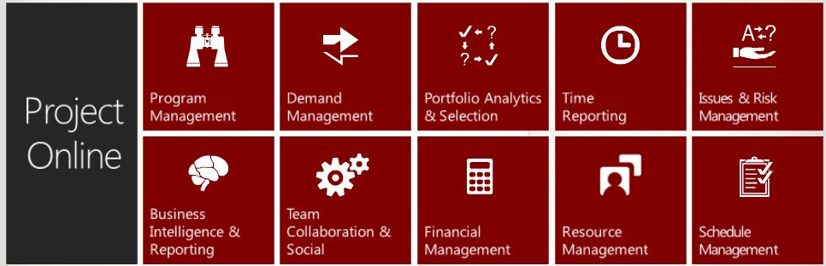
NGSIS Project Central features

Slide 16
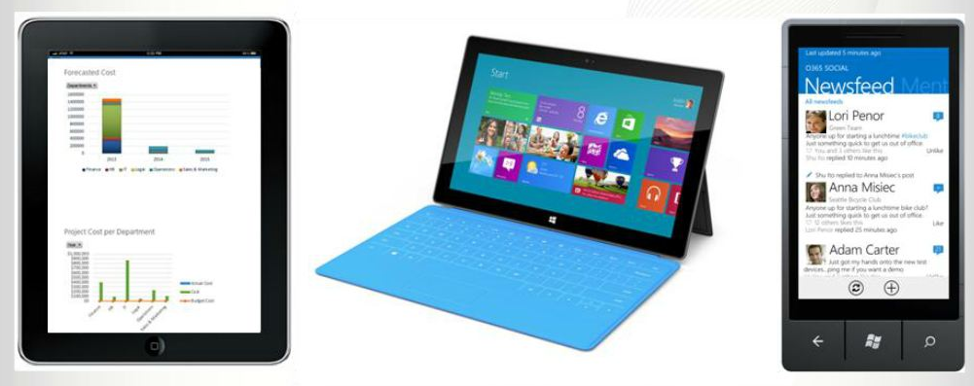
Built for Mobile capability

Slide 17
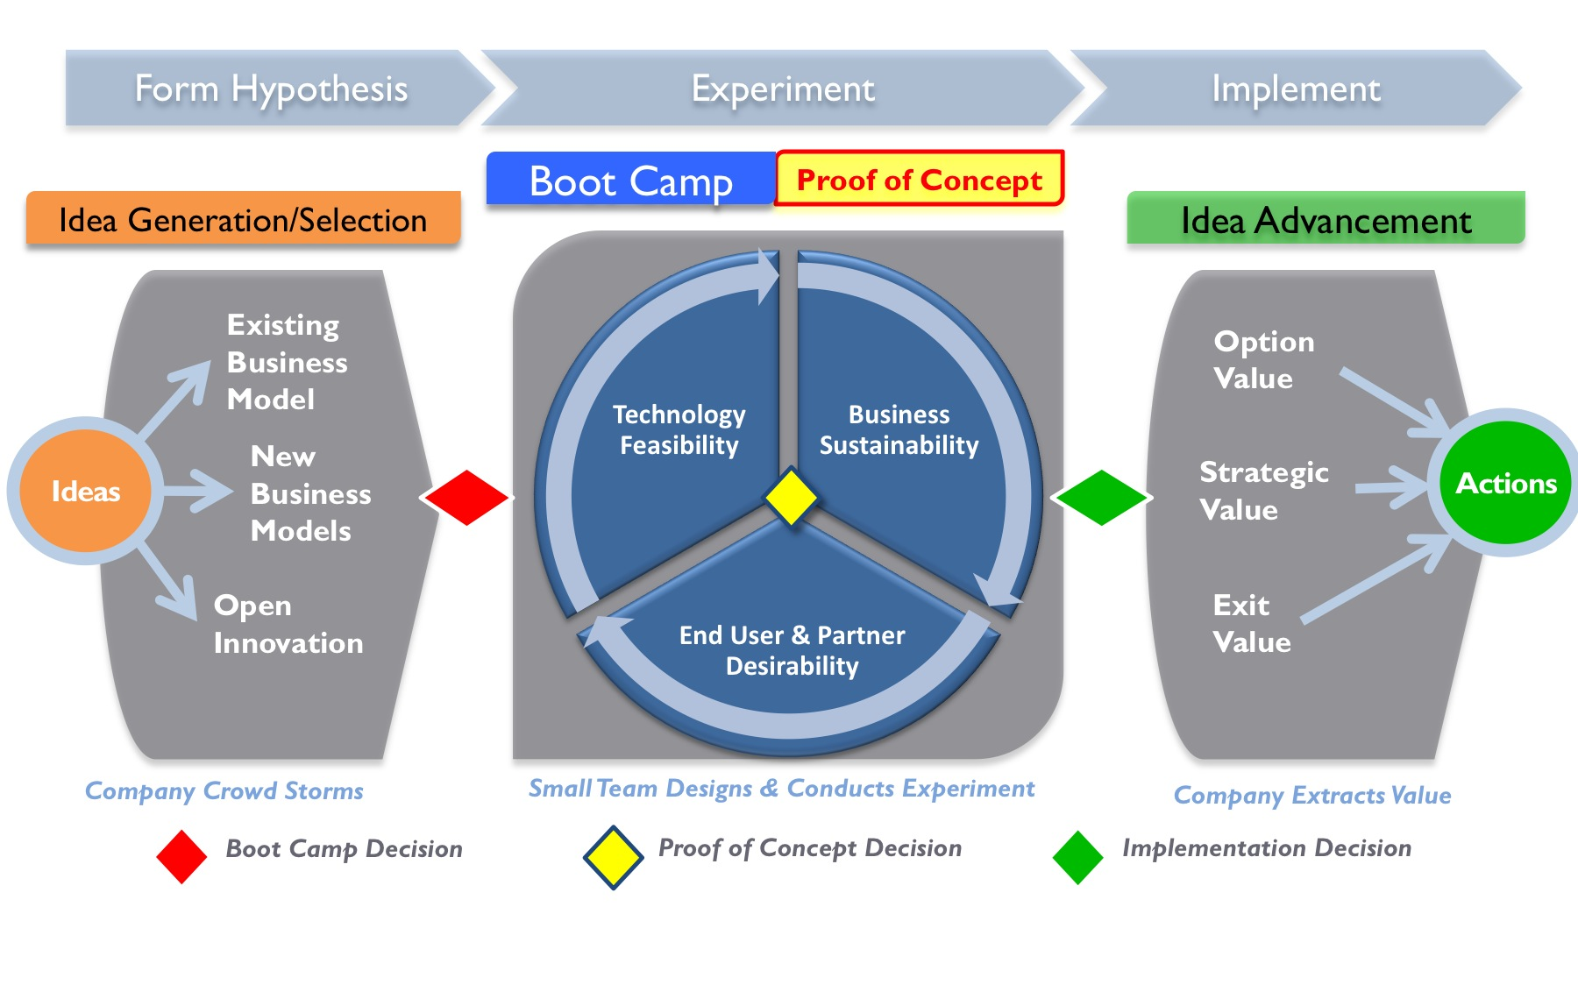
The NGSIS Approach

Slide 18

CHANGE MANAGEMENT

Slide 19

The Psychology of change

Slide 20


Slide 21




Project Life Cycle Management
Iterative or Waterfall
Agile
Support/ Operations
Methodology
Scoping
Planning/Architecture
Execution
Test/QA
Production
Legend:
MS Project
GreenHopper | PM continues to track project progress in Project Online
JIRA | PM continues to track project progress in Project Online

Slide 22
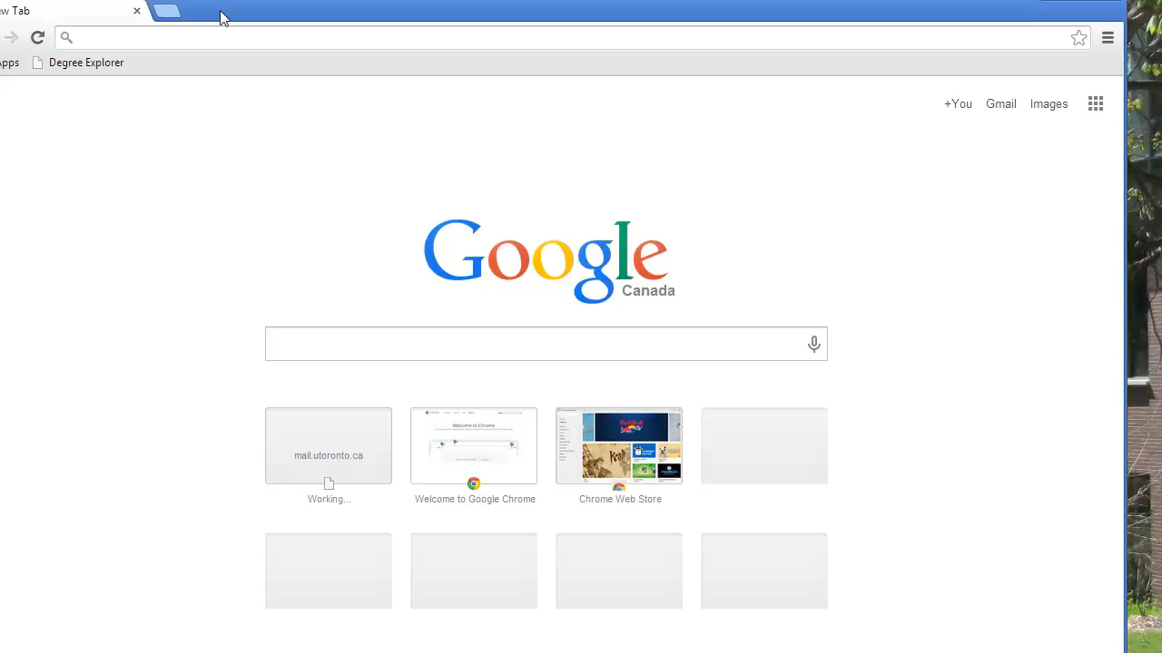
Rubber hits the Road

Slide 23

User Endorsement
“With 10-15 projects running concurrently at any one time on NGSIS, It is vital that we are able to view project deadlines, issues and resource challenges at a glance. Project On-Line provides us with a complete solution to manage our portfolio of projects from start to finish”
-Cathy Eberts, Director, Solutions Development
“I really do believe that this software will enable better collaboration and resource utilization in our department and global teams cannot function effectively without such tools.”
-Brenda Boshoff, Senior Database Developer

Slide 24

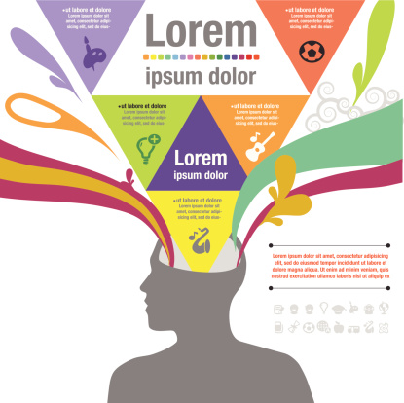




Bringing it HOME
Vision
Goals
Tech
Next Generation
Project Management
Approach
Partnerships
Change Management
Effective Teams

Slide 25
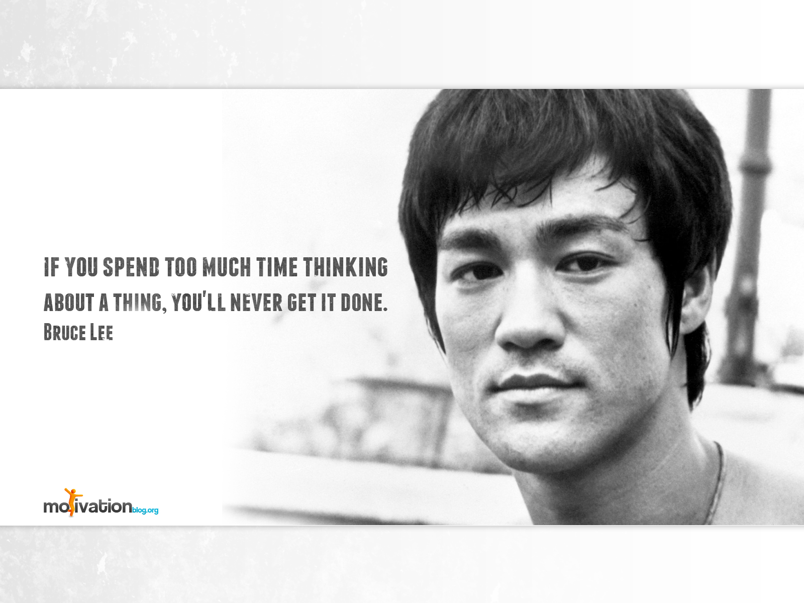
Bringing it HOME

